Slide 1

E&P Weekly Update 5
October 12, 2015
Week 6
17 Days until PDR (Oct 29th)

Slide 2
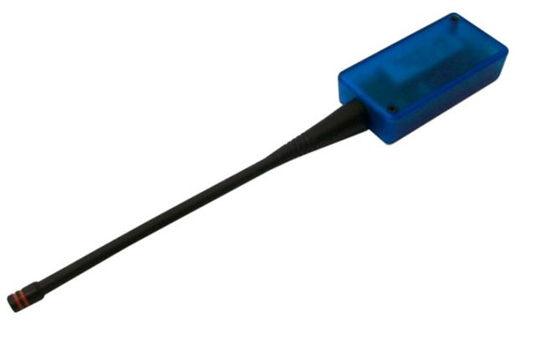
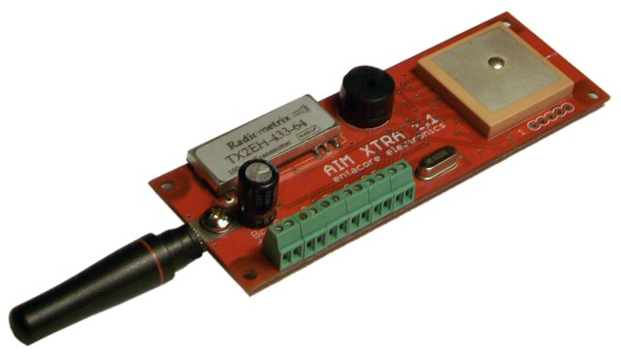
Electronics
Picked a new primary flight computer
AIM XTRA + AIM BASE ($420)
Capable of telemetry off the shelf, includes antennas and everything needed for ~20 mile LOS range

Slide 3
Telemetry Testing
Performed connectivity test using SRT-2 body tube (w/o nosecone), and BeeLine GPS
Achieved/maintained satellite connectivity in all orientations
Ham radio connectivity was fairly reliable as well
Still need to perform full range test to determine range of the Ham system
The SRT-2 E-bay body section is RF transparent, but is also likely range reducing
We expect the new flight computer to over compensate for range enough, meaning structures should be able to reuse last year's design for RF transparency

Slide 4

Avionics Mounting & Payload
Working on the mounting bay in solidworks
Will work with structures to ensure compatibility and flawless interfacing
Still waiting to hear from Austrailia

Slide 5
Launch Box
Exploring cost effective options for launch box design - AC or DC power
DC is leading at the moment
Successfully created experimental control circuit using Arduino and auto relay

Slide 6
Supporting Propulsion
Approaching PDR with two ignition options
Using launch box
Using on-board computer and xbee
Decision will be made post-PDR once power requirements are known
Engine safety system considerations underway

